Slide 1
A Study on Product Data Visualization With ML
By:-
Aman Singh
Arohi Shrivastava
Ashutosh Choubey
Ankit Talreja Sahitya
Kush Jain

Slide 2
Problem Statement :
The problem identified in this project is the difficulty in finding relevant information on Amazon/Flipkart mobile product pages using natural language queries. Different types of users ask queries in a different manner regarding a particular mobile feature that makes the problem of finding relevant information even more complicated.

Slide 3
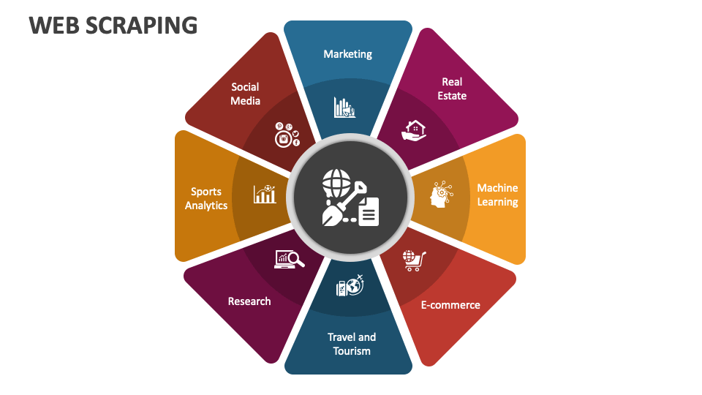
Why the problem is important ?
This project is important because it addresses the problem of information overload and difficulty in finding relevant information on e-commerce platforms. By enabling users to find the information they need on Amazon mobile product pages using natural language queries, we can improve the user experience and help users make informed purchasing decisions. Furthermore, this project demonstrates the practical application of NLP (Natural Language Processing) and Information retrieval techniques in solving real-world problems.

Slide 4
Methodology:
Approach-1:
Our proposed approach will use a combination of web scraping, data preprocessing, and query processing to extract relevant information from Flipkart mobile product pages. We will use NLP techniques to preprocess the user query and extract the relevant keywords. Then, we will use web scraping techniques to extract the relevant information from the Amazon product page. Finally, we will use NLP techniques to generate a human-like response to the user query.

Slide 5
Methodology:
Approach 2:
Our Second approach involves using NLP and IR techniques to build a query answering system that can understand user queries in natural language and retrieve relevant information from Amazon's mobile product pages. We plan to use the following techniques and algorithms : Named entity recognition (NER) to identify key product details in user queries such as brand, model, and features. Then we’ll use Text summarization technique to extract important information from product descriptions and reviews. This approach will be more like Question answering (QA) models like BERT to answer user queries by analyzing the extracted information.

Slide 6
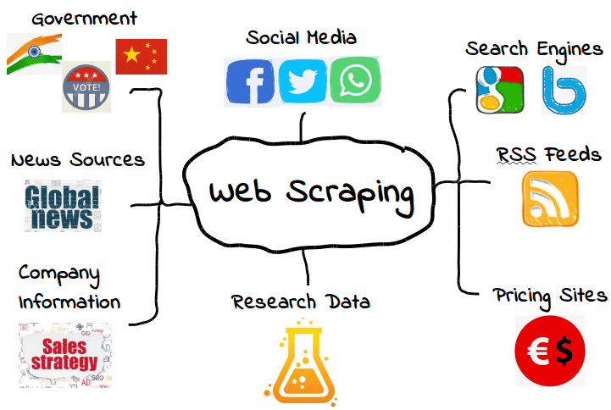
The Rise of E-commerce and Web Scraping
Introduction to the growth of online shopping
Explanation of web scraping and its automated processes
Overview of the technology used for web scraping
The significance of web scraping for businesses and competition
Web scraping for data acquisition and transformation into commercial resources

Slide 7
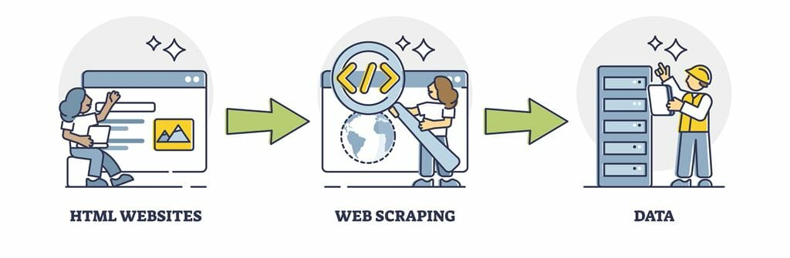
Web Scraping and Data Analysis Technique Flow Diagram
Detailed description of the three-phase approach
Web scraping phase: extraction and storage of data in CSV format
Data analysis phase: application of statistical methods to the extracted data
Data visualization phase: use of data visualization tools to convey outcomes of analysis
Utilization of Flask, a Python-based web framework, to create a user-friendly graphical user interface

Slide 8
Training and Test Data
We collected training and test data for our research.
Training data was acquired from sources like Kaggle and numerous webpages from Google.
We gathered roughly 750 questions posed on different mobile phone features such as battery, camera, processor, and storage, among others.
Some of the questions were similar yet asked in different ways. However, they were classified into one feature of the mobile phone.
Test data was acquired from e-commerce websites such as Amazon and Flipkart.
The test data consisted of questions asked by users in the "question and answer" area of a certain product.
We selected to collect test data from e-commerce websites since the queries featured there are asked in straightforward human language.
This would let us test our training data successfully.

Slide 9
Model Applied on Data
MODEL APPLIED | ACCURACY | PRESICION
LSTM | 78% | 76.8%
SVM | 94% | 93.8%
Logistic Regression | 92% | 93%
ADA BOOST | 85% | 84.6%
Bert | 68% | 67.08%
.

Slide 10
Naive Bayes Text Classification
Naive Bayes is a probabilistic technique that is extensively used for classification, especially in natural language processing and text classification.
The method is "naive" because it assumes that each feature (or word) in the input is independent of every other characteristic.
In text classification, each document is represented as a bag of words (or a list of word frequencies), and the Naive Bayes method calculates the likelihood of each document belonging to a certain class.
The algorithm estimates the prior probability of each class (i.e., the proportion of documents in the training set that correspond to each class) and the conditional probability of each word given each class.
To classify a new document, the algorithm determines the likelihood of the document belonging to each class using Bayes' theorem, which takes into consideration both the prior probability and the conditional probability.
Finally, the algorithm allocates the document to the class with the highest probability.
Naive Bayes is a prominent technique in text categorization due to its simplicity and efficiency. It is also known to perform effectively even with limited quantities of training data.

Slide 11
Cosine Similarity
Cosine similarity is a measure of similarity between two non-zero vectors and is extensively used in text-based applications such as document comparison, information retrieval, text mining, and recommendation systems.
The measure estimates the cosine of the angle between the two vectors, which spans from 0 (no resemblance) to 1 (perfect similarity).
In text-based applications, the vectors often indicate the frequency of words in the documents.
To determine cosine similarity, the dot product of the two vectors is divided by the product of their magnitudes.
The resulting value shows the cosine similarity between the two vectors.
Cosine similarity is effective in finding comparable documents or items, and is widely used to develop recommendation systems for products, movies, or other items based on their similarities in characteristics or content.
It is a regularly used similarity measure in natural language processing and text mining due to its efficacy in capturing semantic links between words and documents.

Slide 12
Outcomes
After training and testing our Naive Bayes model on the collected data, we attained an accuracy of 0.8838.
This accuracy score indicates that the model accurately classified 88.38% of the test data.
While an accuracy of 0.8838 is regarded high, it is crucial to remember that the model's performance may vary based on the specific data it is applied to.
To increase the model's accuracy, we can explore additional preprocessing approaches like as stemming, stop-word removal, or TF-IDF vectorization.
Additionally, we can study alternative classification methods such as support vector machines, decision trees, or random forests to further increase the accuracy of the model.
Overall, the Naive Bayes model has proved its usefulness in text classification tasks and might be a useful tool for numerous applications in natural language processing and machine learning.

Slide 13
Results and Comments
We developed a user-friendly graphical user interface (GUI) using Flask, a Python-based web framework, for our web scraping and data analysis system.
The Flask app allows users to enter a URL for an e-commerce website and automatically retrieve and store data in CSV format.
We tested our system using Flipkart, a popular Indian e-commerce website, and successfully extracted product names, prices, and ratings for a selected category of products.
Data analysis using statistical methods, such as mean and median, revealed insights into product pricing and ratings trends.
Our findings suggest that web scraping and data analysis can provide valuable insights for businesses seeking to understand customer behavior and market trends.
However, it's important to note that web scraping may present legal and ethical challenges, and caution should be exercised in the use of such techniques.

Slide 14
Initial Stage: Product Scraping and Feature Extraction
Introduction:The first stage of our Flask app involved scraping product data from an e-commerce website and extracting relevant features and specifications.
Product Scraping:We used web scraping techniques to extract data from the website, including product name, brand, price, image, and description.We leveraged the BeautifulSoup library to parse the HTML and extract relevant information.
Feature Extraction:
After scraping product data, we then utilized natural language processing (NLP) techniques to extract key features and specifications of each product.
We used spaCy, a popular NLP library, to process the product descriptions and identify important features such as size, color, material, and usage instructions.
We also utilized regular expressions to extract numerical values such as weight, dimensions, and capacity.

Slide 15
Initial Stage: Product Scraping and Feature Extraction
Challenges:The main challenge in this stage was dealing with the variety and complexity of the product data.The e-commerce website had a wide range of products with varying descriptions and formats, making it difficult to extract consistent features across all products.
Conclusion:Despite the challenges, we were able to successfully scrape product data and extract relevant features and specifications using a combination of web scraping and NLP techniques.This laid the foundation for further stages of our Flask app, including product recommendation and comparison based on extracted features.

Slide 16
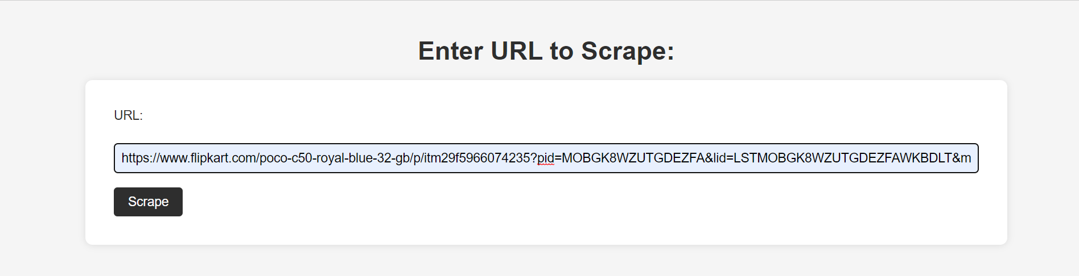
Initial Stage:

Slide 17
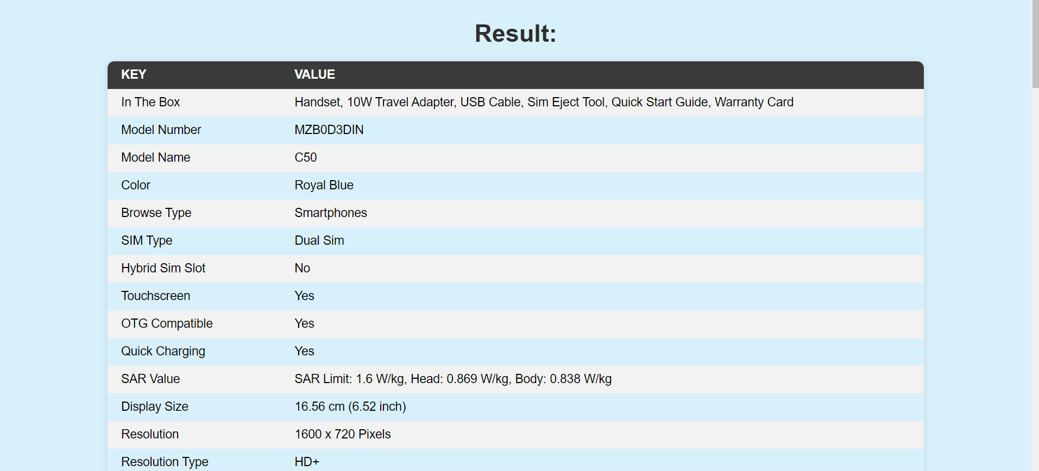
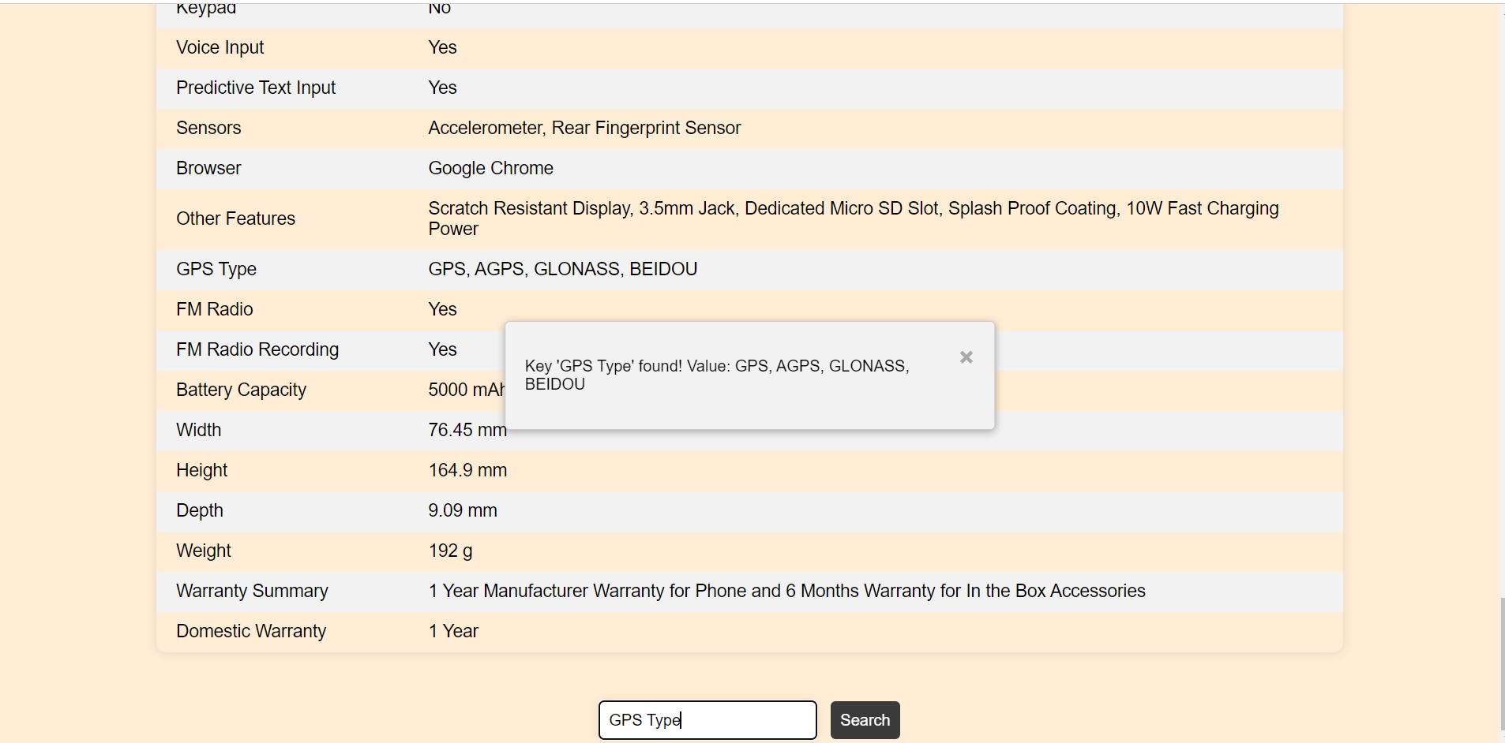
Initial Stage:

Slide 18
Second Stage: Similarity Functions and Improved Searching
Introduction:In the second stage of our Flask app, we improved the searching feature by implementing similarity functions and making the search more feasible.
Similarity Functions:
We used several similarity functions to compare the features and specifications of different products.
Cosine similarity was used to compare the overall similarity between two products based on their feature vectors.
Jaccard similarity was used to compare the similarity of two sets of features, such as color and material.
Levenshtein distance was used to calculate the edit distance between two strings, such as product names or descriptions.
Improved Searching:We implemented a search bar on the website, allowing users to search for products based on keywords or phrases.When a user enters a search query, our app applies the similarity functions to the product database and returns the most relevant products.The search results are ranked based on their similarity scores, with the most similar products appearing at the top.

Slide 19
Second Stage: Similarity Functions and Improved Searching
Challenges:One of the challenges in this stage was optimizing the search function for efficiency and speed, especially with a large product database.We also had to carefully choose and fine-tune the similarity functions to ensure accurate and relevant search results.
Conclusion:By implementing similarity functions and improving the search feature, we were able to provide users with a more efficient and user-friendly experience.This stage built upon the previous stage's work of product scraping and feature extraction, and laid the foundation for further stages of our Flask app, such as product recommendation and comparison.

Slide 20
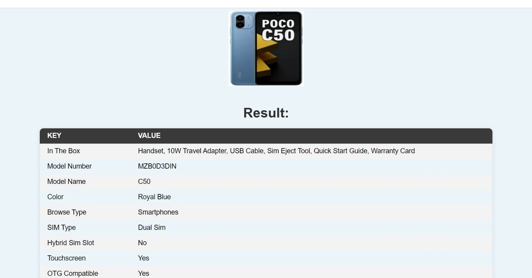
Second Stage:

Slide 21
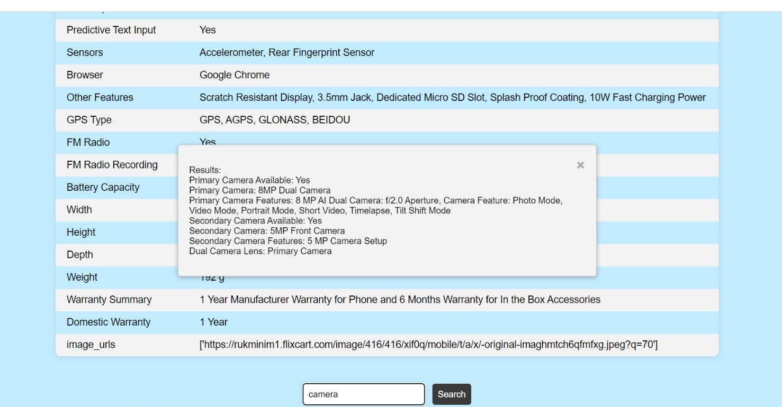
Second Stage:

Slide 22
Final Stage: Product Classification and Smart Search
Introduction : In the final stage of our Flask app, we classified products into different categories based on their features and implemented smart search algorithms to improve the search experience.
Product Classification : We used ML algorithms such as decision trees and support vector machines to classify products into different categories based on their features.We identified several key features that were most important to users, including memory and storage, battery and power, and display.Each product was then categorized into one of these categories based on its feature vector.
Smart Search : We implemented smart search algorithms to improve the search experience for users.We used sentiment analysis to process user comments and feedback, and incorporated the results into the search algorithm to improve results.We also implemented auto-correct functionality to correct typos and misspellings in search queries.Finally, we used clustering algorithms to group similar products together in search results, making it easier for users to find what they are looking for.

Slide 23
Final Stage: Product Classification and Smart Search
Challenges : One of the main challenges in this stage was developing accurate and efficient classification and search algorithms, especially with a large and diverse product database.We also had to carefully evaluate and fine-tune the algorithms to ensure relevant and accurate search results.
Conclusion :By implementing product classification and smart search algorithms, we were able to provide users with a highly efficient and personalized search experience.This final stage built upon the previous stages of product scraping and feature extraction, and similarity functions, and resulted in a robust and user-friendly Flask app that can be used to search and compare products across different categories.

Slide 24
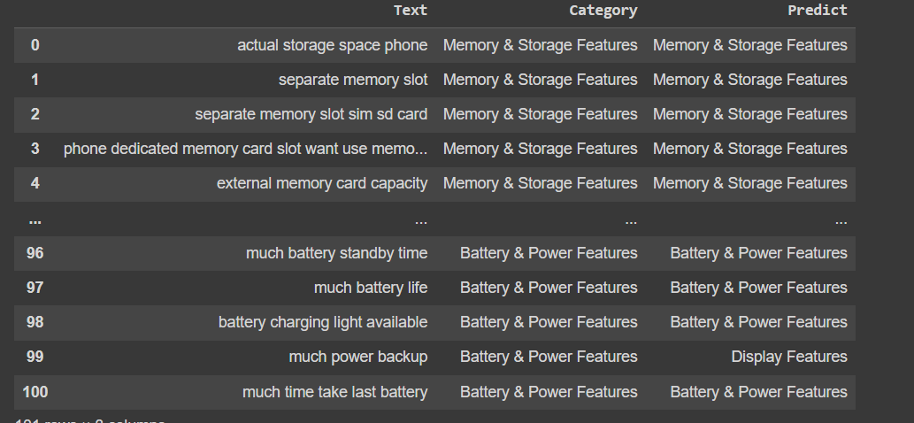
Final Stage: Product Classification and Smart Search

Slide 25
Future Scope: Integration and User-Friendly Interface
Introduction:The final stage of our Flask app achieved an accuracy of 93.07% in product classification and smart search algorithms.In the future, we plan to integrate these features into our existing app and make it more user-friendly.
Integration:We plan to integrate the product classification and smart search features into our existing app, allowing users to easily search and compare products across different categories.We also plan to optimize the algorithms for speed and efficiency to ensure a seamless user experience.

Slide 26
Future Scope: Integration and User-Friendly Interface
User-Friendly Interface:We plan to improve the user interface of our app, making it more intuitive and user-friendly.We will incorporate user feedback to make necessary changes and improvements to the app's design and functionality.We also plan to implement additional features such as personalized recommendations based on user preferences and purchase history.
Challenges:One of the challenges in the future scope will be ensuring scalability and maintainability of the app as the product database grows and user traffic increases.We will need to continually evaluate and fine-tune the algorithms to ensure accurate and relevant search results.

Slide 27
Future Scope : Integration & user friendly Interface
Conclusion : The future scope of our Flask app involves integrating product classification and smart search features and making the app more user - friendly. With these improvements, we aim to provide users with a highly efficient and personalized search experience that meets their needs and preferences.

Slide 28
Contribution from team members
Arohi Shrivastava & Ashutosh Choubey
→front end development
→Report preparation
→web scrapping
-->Literature review
Aman singh
→Implementation of different models, collection of dataset.
→ End to end pipeline implementation
Ankit Talreja & Kush jain
→ Web scraping and collection of dataset.
→PPT presentation
→Literature review

Slide 29
Thank You

